Slide 1

RNN on Time Series Data

Slide 2
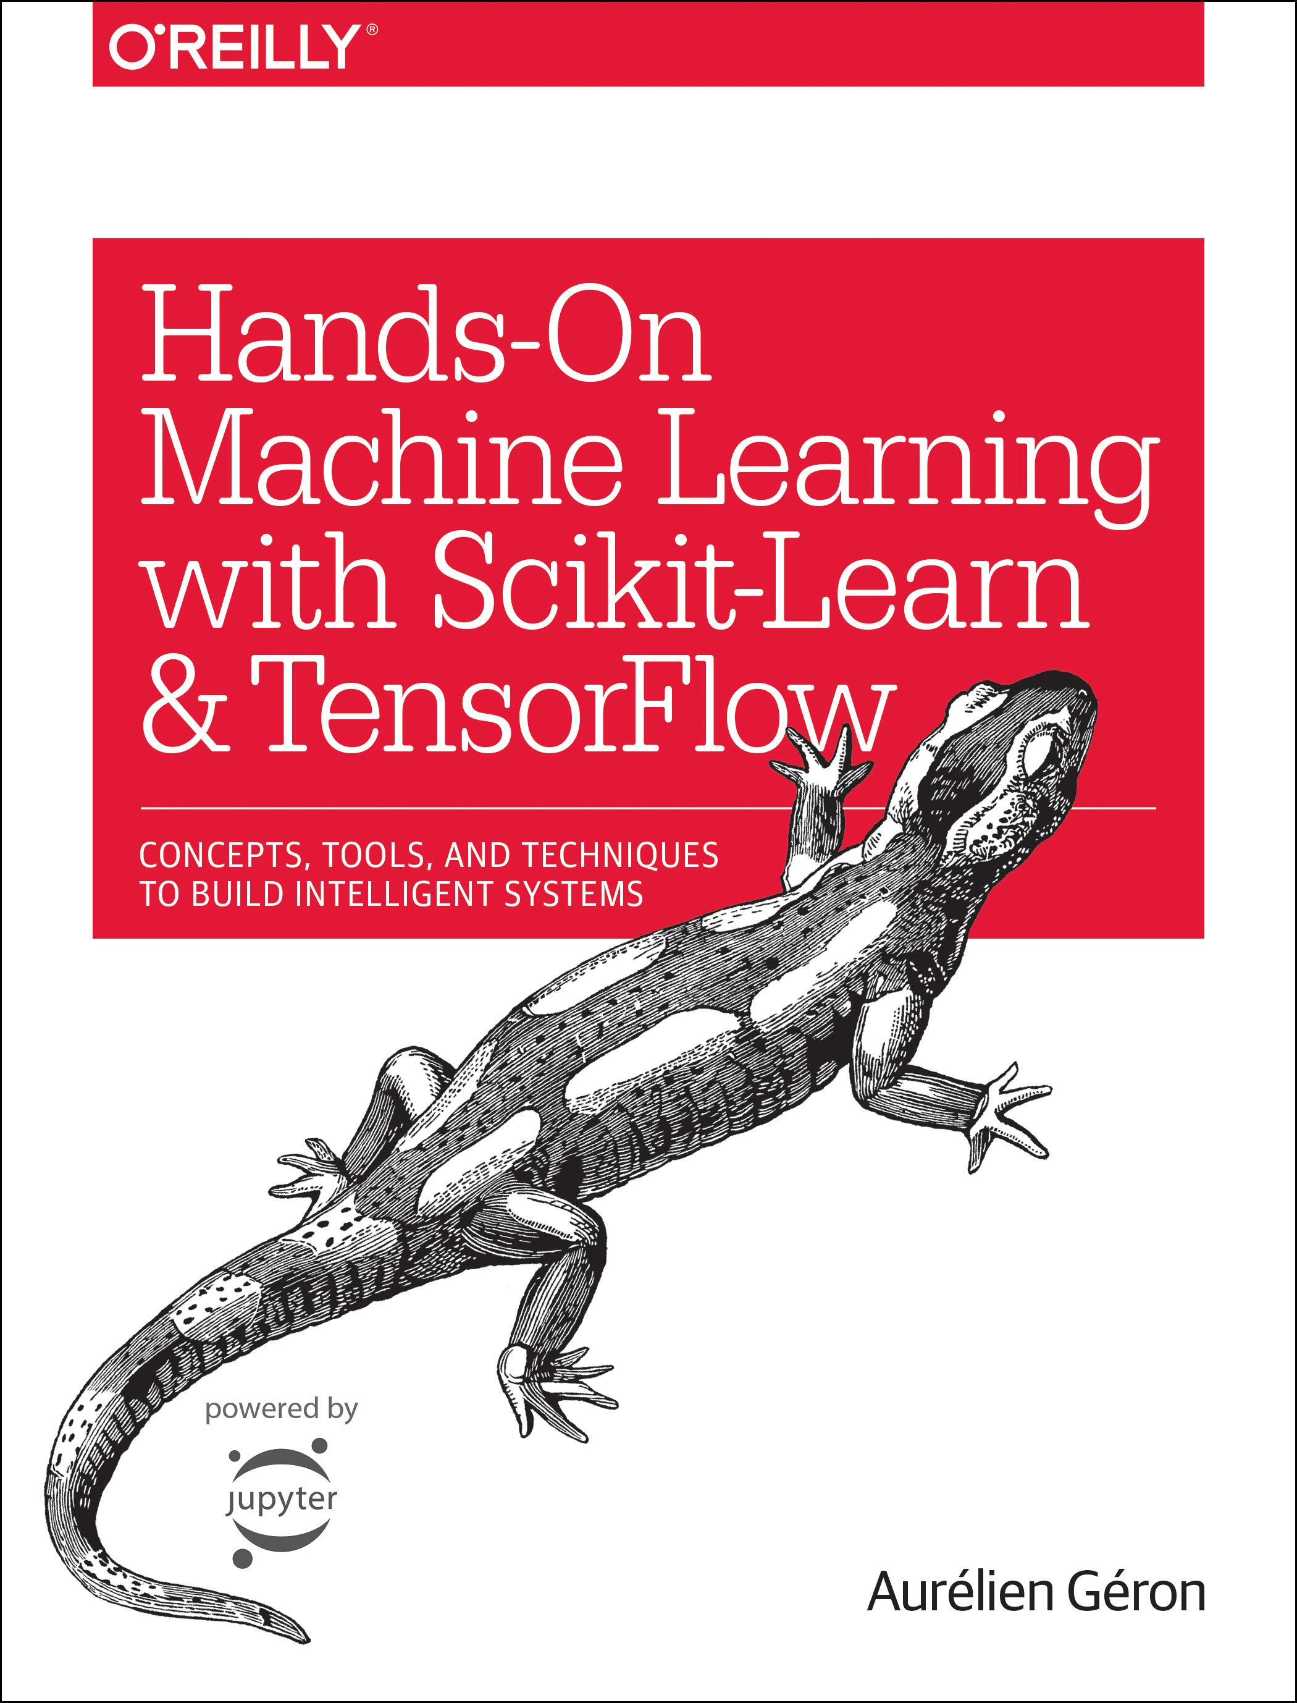
Reference
Chapter 14 (O'Reilly) of Hands-On ML
Youtube on Saving Figure
Youtube on Numpy Broadcasting
Youtube
Code

Slide 3
Data

Slide 4
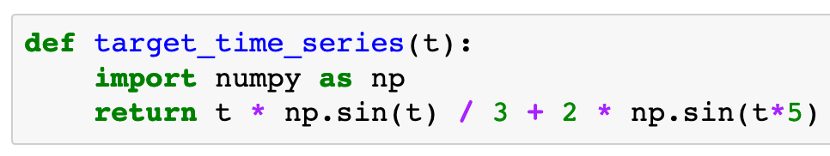

Slide 5
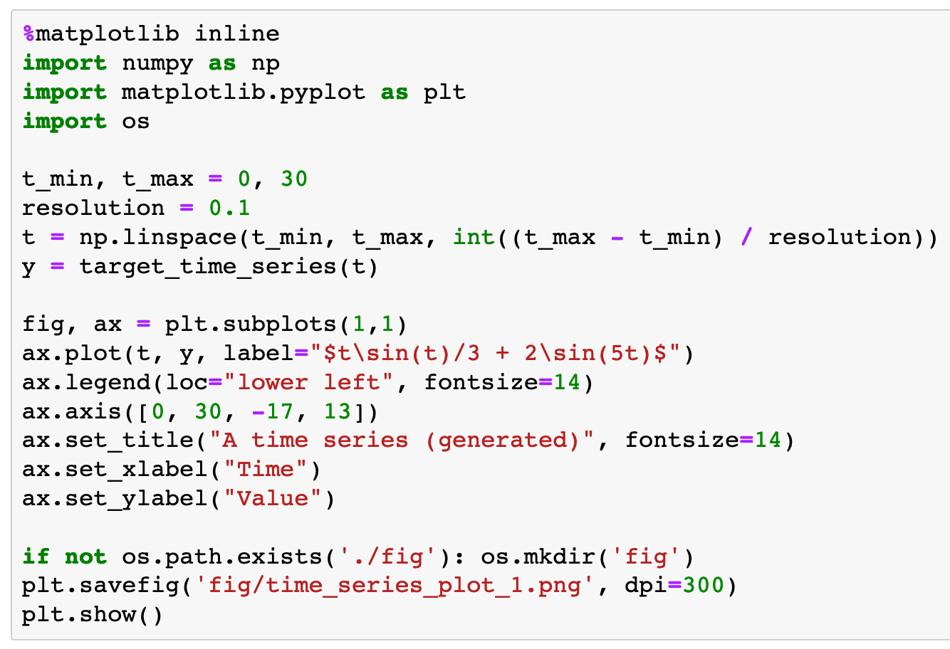

Slide 6
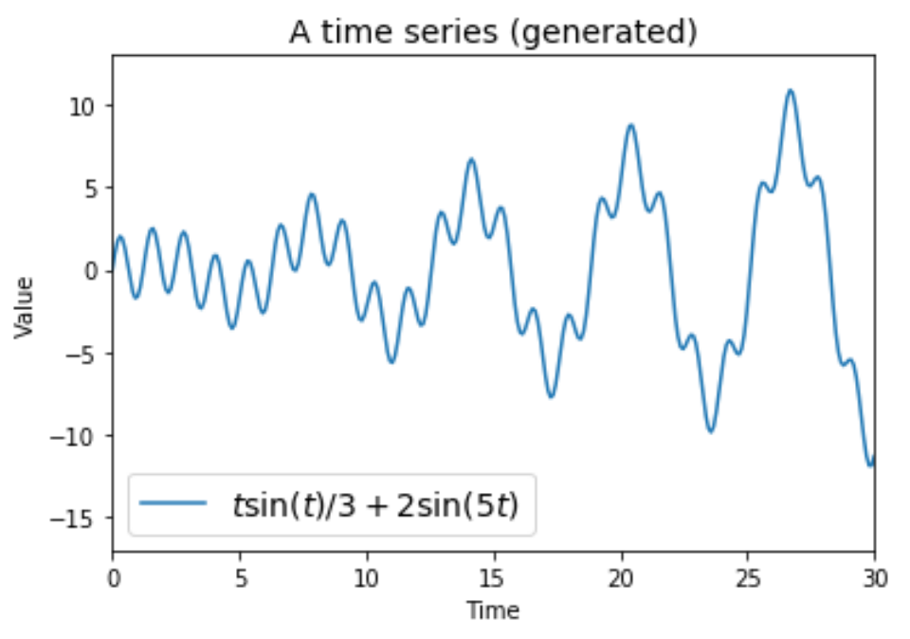

Slide 7
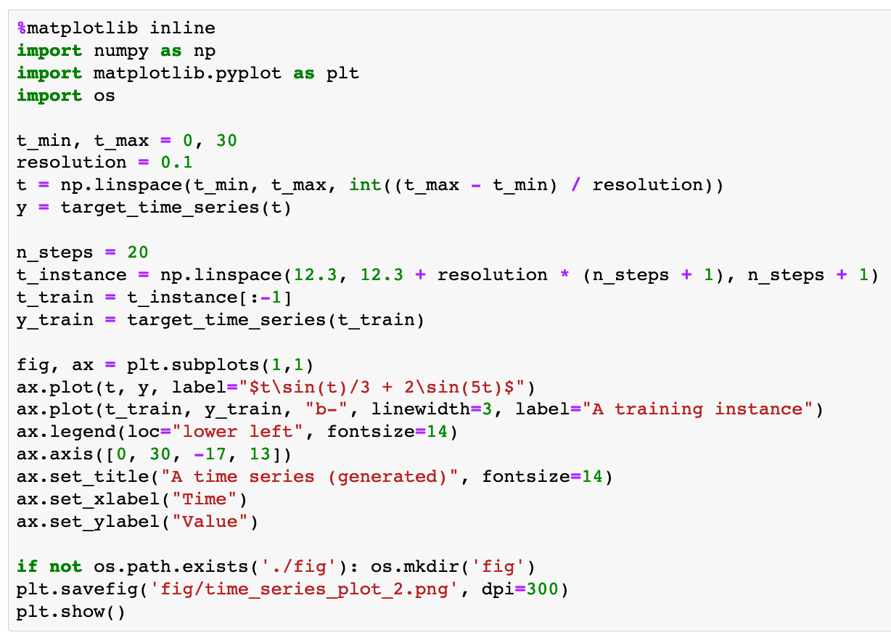

Slide 8
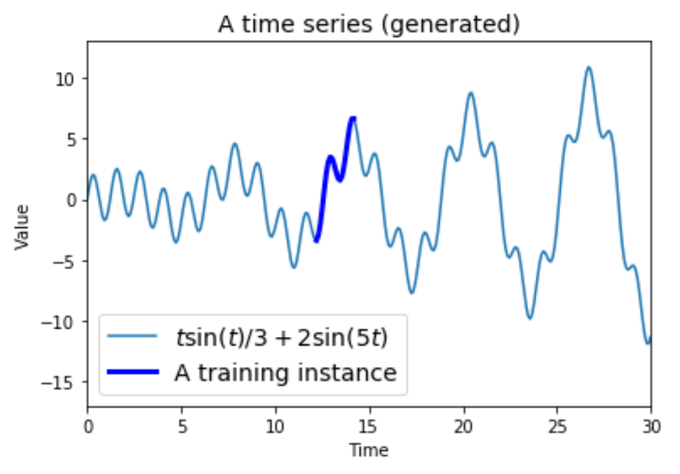

Slide 9
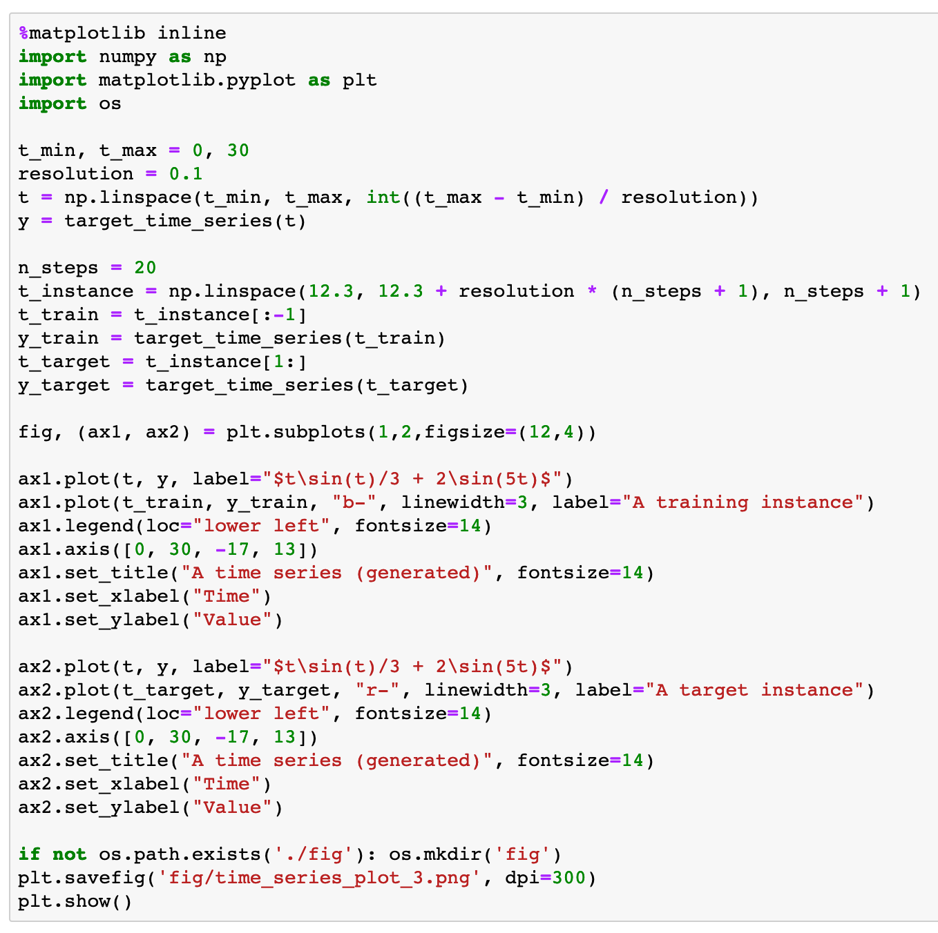

Slide 10
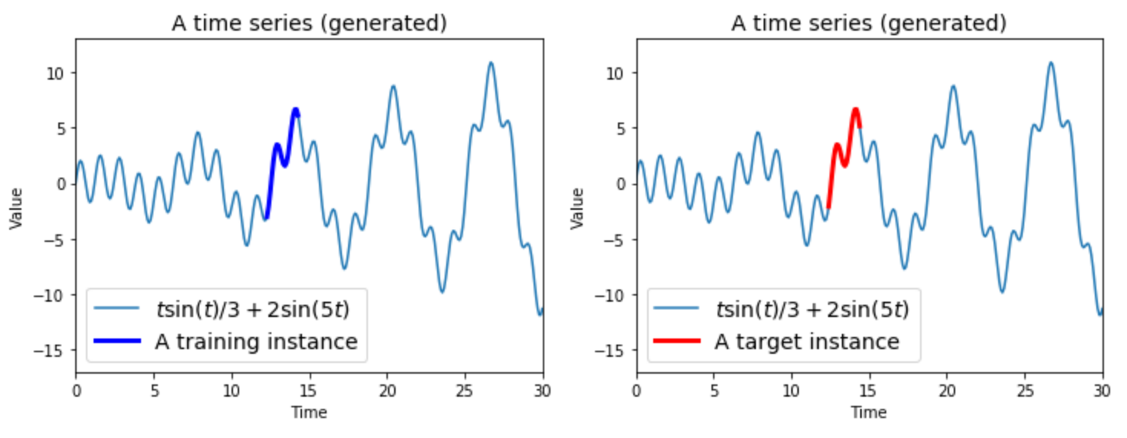

Slide 11
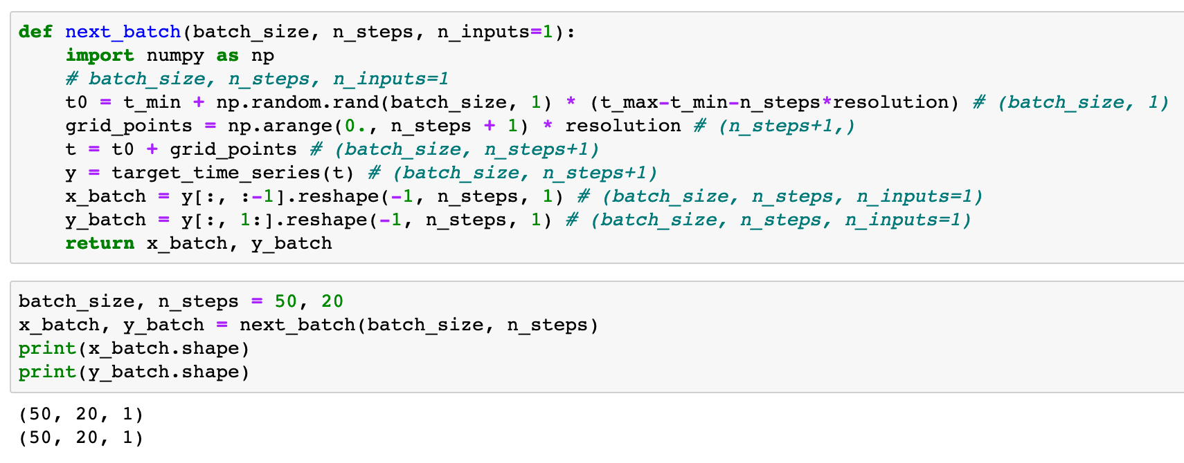


Slide 13
Warm Up

Slide 14
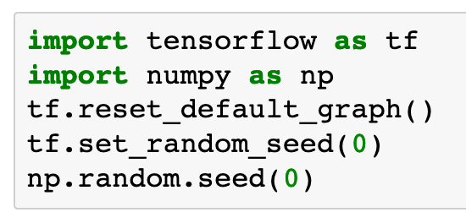

Slide 15
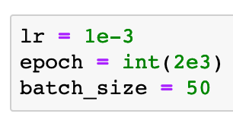

Slide 16
Graph

Slide 17
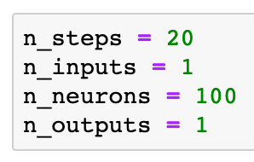

Slide 18
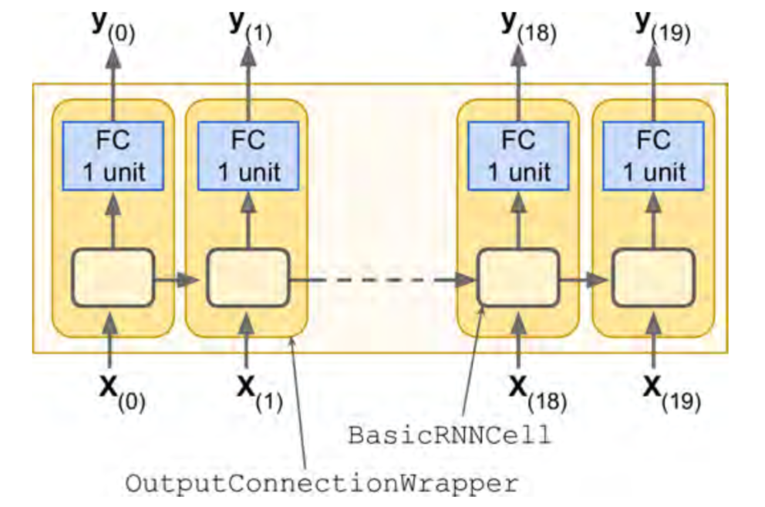
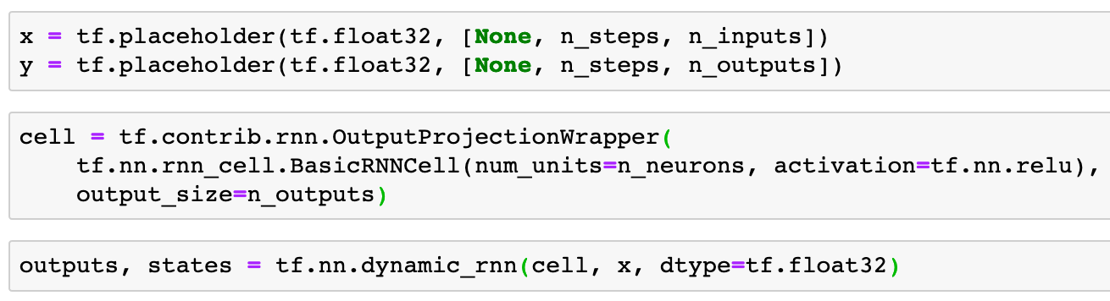
Chapter 14 (O'Reilly) of Hands-On ML

Slide 19
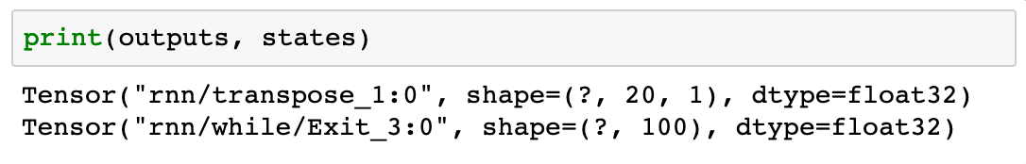
Chapter 14 (O'Reilly) of Hands-On ML

Slide 20
Chapter 14 (O'Reilly) of Hands-On ML

Slide 21
x
Chapter 14 (O'Reilly) of Hands-On ML

Slide 22
x
(batch_size, n_steps, n_inputs)
Chapter 14 (O'Reilly) of Hands-On ML

Slide 23
x
(batch_size, n_steps, n_inputs)
Chapter 14 (O'Reilly) of Hands-On ML

Slide 24
(batch_size, n_steps, n_neorons)
x
(batch_size, n_steps, n_inputs)
Chapter 14 (O'Reilly) of Hands-On ML

Slide 25
outputs
(batch_size, n_steps, n_neorons)
x
(batch_size, n_steps, n_inputs)
Chapter 14 (O'Reilly) of Hands-On ML

Slide 26
outputs
(batch_size, n_steps, 1)
(batch_size, n_steps, n_neorons)
x
(batch_size, n_steps, n_inputs)
Chapter 14 (O'Reilly) of Hands-On ML

Slide 27
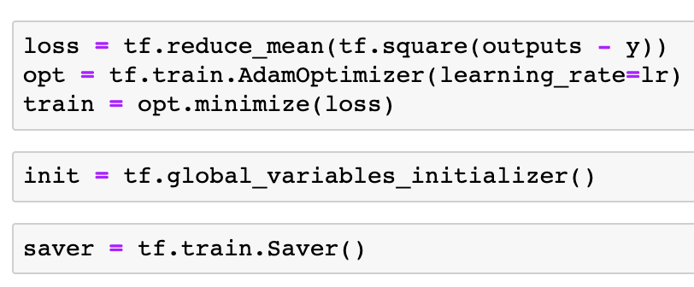

Slide 30
Session

Slide 31
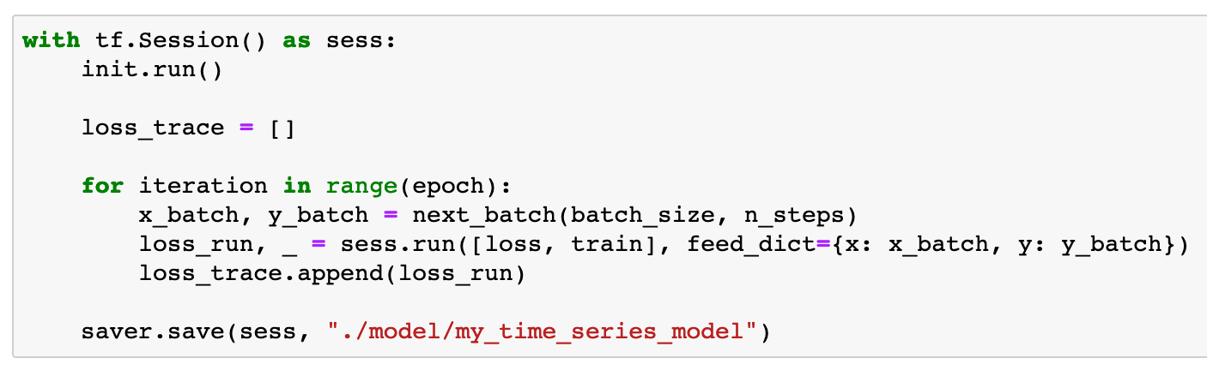

Slide 32
Report Result

Slide 33
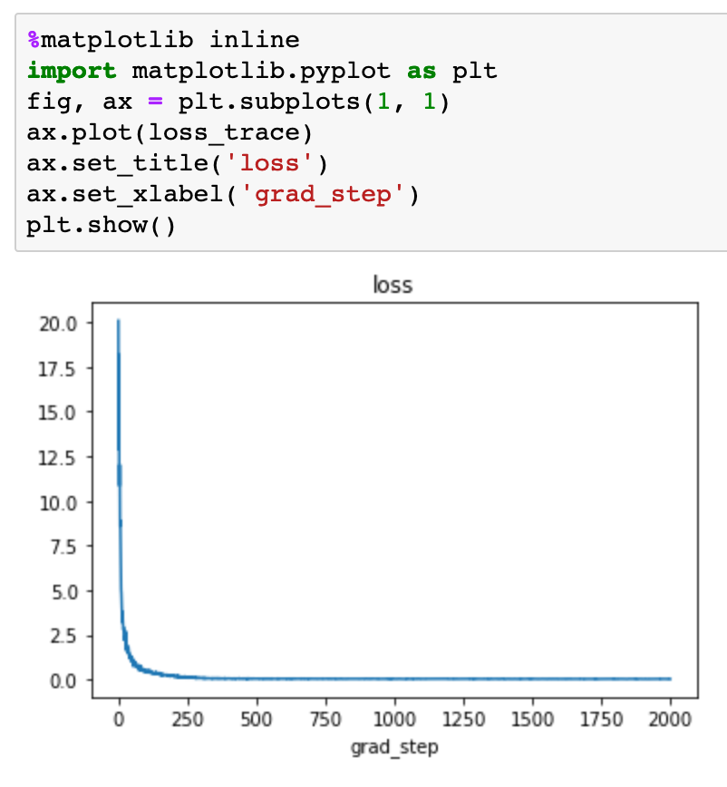

Slide 34
Restore and Predict

Slide 35
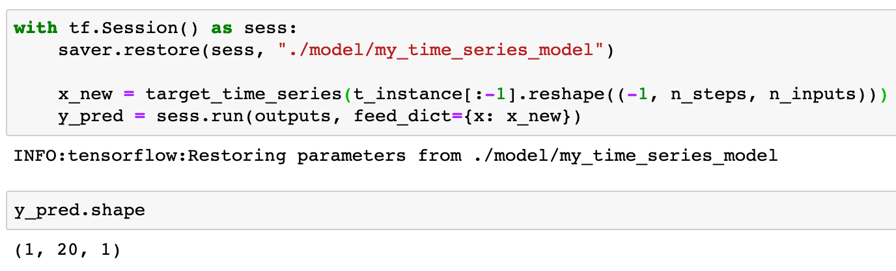

Slide 37
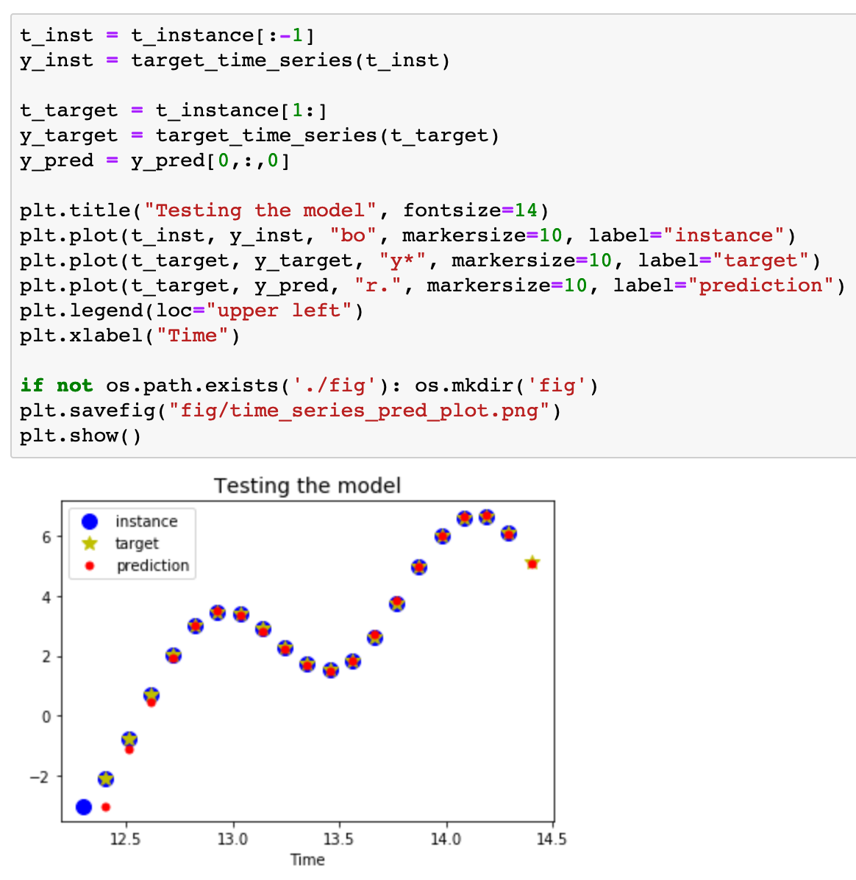

Slide 38
Now
Let’s Play with Code

